Slide 1
Group project
Epoka University
Business informatics
Software development
M.Sc Enesh Orazova

Slide 2
Our group is composed of 5 member: Ijad Jukaj , Xhoslin Agovi, Rindi Daja , Denald Selimi and Klaiv Domi.
Ijad Jukaj (me) - focused a little in static and more in the dynamic part of the website (HTML, JAVASCRIPT, PHP, CRUD system of the web, context model).
Xhoslin - Focused in login system and database [Admin login system and user login system (PHP, HTML, log in , sing out,)], Use case diagram .
Rindi Daja - Focused totally in database design (MYSQL), Website Application Specification.
Klaiv Domi - focused totally in design and in the static part of the website (HTML, CSS, BOOTSTRAP) Website Requirements.
Denald Selimi – Database connection, footer and header.

Slide 3
Development model:
In this project is used the reuse model. We integrated existing components from Bootstrap and other websites, to build this final project.

Slide 4
User requirements:
a) student(normal user)
b) administrator
The students can register and after that process, they get an ID.
After the login process, the students can access the main menu.
The students can view the book catalog in the library.
The students can update their profile.
The students can view issued books and their return time.
The students can change and reset their password.
The administrator can add, update and delete book categories, authors and books.
The administrator can issue new books to students and also update the database when students return books.
The admin can search students by ID.
The administrator can view student details in the database.
The administrator can update his own password.

Slide 5
Website Application Specification
Registration:
Students can register on the website by providing their details.
After successful registration, a unique ID is assigned to each student.
Login:
Students can log in to the website using their registered ID and password.
Authentication should be performed to ensure secure access.
Main Menu:
After logging in, students should be directed to the main menu.
The main menu provides navigation to different features of the website.
Book Catalog:
Students can access and view the catalog of books available in the library.
The book catalog should include information such as book title, author, category, and availability status.
Profile Update:
Students can update their profile information, including personal details and contact information.
They should have the ability to modify their name, email, phone number, and any other relevant details.
Issued Books:
Students can view the books they have borrowed from the library.
The system should display information about the issued books, such as the book title, due date, and any overdue charges.
Password Management:
Students should be able to change their password.
A password reset functionality should be provided in case a student forgets their password.

Slide 6
Website Application Specification
Book Management:
The administrator has the authority to add, update, and delete book categories, authors, and books in the system.
They should be able to add new books with details such as title, author, category, ISBN, and availability status.
Existing book information can be updated or removed as necessary.
Issuing and Returning Books:
The administrator can issue books to students upon request.
When a student returns a book, the administrator updates the database accordingly, marking the book as returned.
Student Search:
The administrator can search for students by their unique ID.
This search functionality allows the administrator to quickly access student information when required.
Student Details:
The administrator can view detailed information about students stored in the database.
This information may include personal details, contact information, issued books, and other relevant data.
Password Update:
The administrator should be able to update their own password for security purposes.

Slide 7
Additional Considerations:
Authentication and Security:
Proper authentication mechanisms should be implemented to ensure secure access for both students and administrators.
Passwords should be securely stored using strong encryption techniques.
Database Management:
A database system should be used to store and manage student information, book details, and other relevant data.
The database should be properly designed and optimized to handle the expected load and ensure efficient operations.
User-friendly Interface:
The website should have an intuitive and user-friendly interface, making it easy for students and administrators to navigate and perform tasks.
Error Handling and Validation:
The system should include appropriate error handling mechanisms and validate user inputs to prevent data inconsistencies and enhance user experience.
Responsive Design:
The website should be designed responsively to ensure compatibility with different devices and screen sizes, enabling access from various platforms such as desktops, tablets, and mobile devices.
Accessibility:
Consider implementing accessibility features to ensure the website is usable for individuals with disabilities, conforming to relevant accessibility guidelines and standards.
Performance Optimization:
Optimize the website's performance to provide fast response times and minimize latency, ensuring a smooth user experience even under heavy usage conditions.

Slide 8
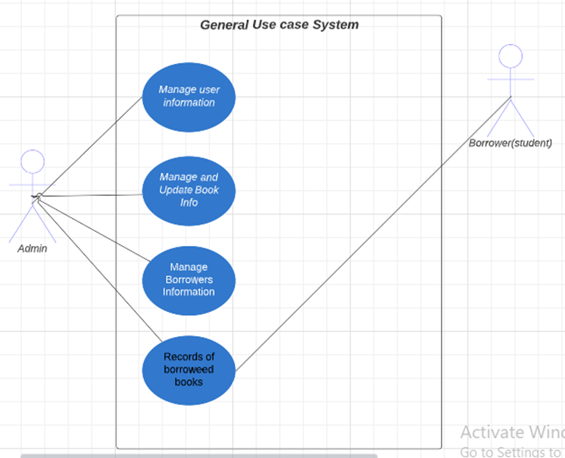
Use Case Diagram for Library Management System
● General use Case
The aim of a use case diagram is to illustrate how various entities known as actors engage with the use case and to record the fundamental functions of a system. Here is an example of a use case diagram for a library management system, which depicts the overall processes or activities that the system can perform, based on the tasks carried out by the Admin(librarian) in a library. This diagram displays the use cases required to establish the essential functions of a system. These activities are interlinked to generate an anticipated output for the user.
To further elaborate on the procedures presented in this Library Management System General Use Case, continue reading.
This is the standard usage of a use case diagram. It portrays the primary constituents of the system and the transmission of data among them.
By utilizing this general use case, the developer can use it as a foundation for determining what should be taken into account when designing the library management system.

Slide 9
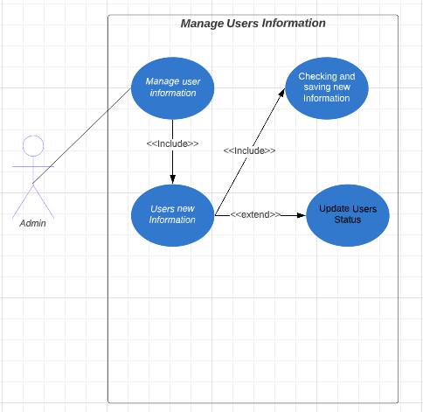
Manage Users Information
This is where the admin or the main user of the system could control the users that could access the system.
As depicted in the diagram, the Admin, acting as an actor, can input specific book details. The system subsequently checks and verifies the accuracy of the information before storing it in the database.
As a programmer, this is a crucial function that the library management system should be able to perform.

Slide 10
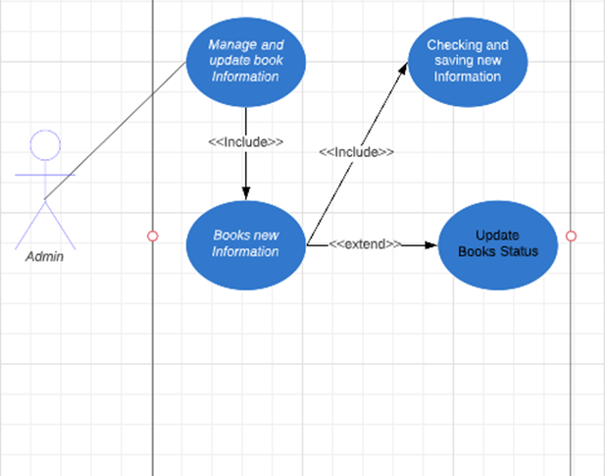
Update Books Information and status
This is the process where users or the library administrator can access the information of each book present in the library. It also enables them to update the book's status, indicating whether it is available or has been borrowed by a borrower or student.

Slide 11
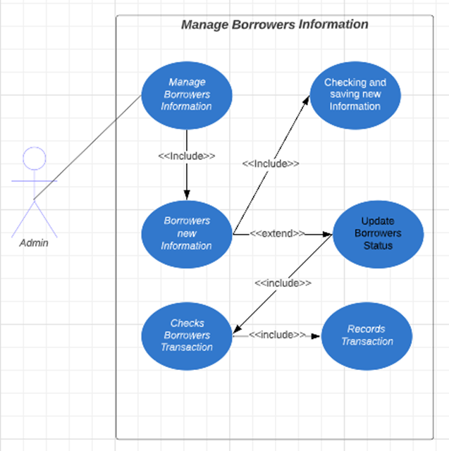
Manage Borrowers (Students) Information
This process describes how the borrower's details are recorded in the system. This information serves as a reference for the admin to monitor the borrower's book transactions within the system.

Slide 12
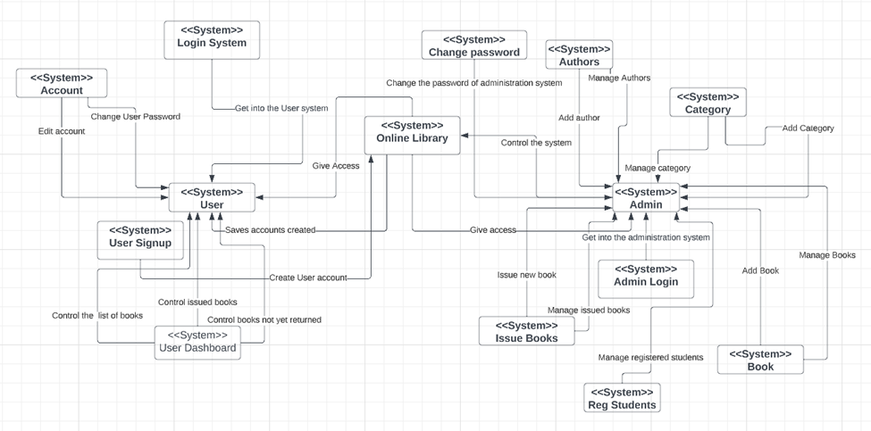
Context Model
In our online library system, the context model refers to a conceptual representation of the various elements that make up the system, including users, books, resources, and the relationships between them.
The context model provides a high-level overview of the system's functionality, helping developers and stakeholders understand how the various components interact with each other. This understanding is crucial for designing and implementing the system effectively.
For example, in our application, the context model may include the following elements:
•Users: This includes students, faculty, and other members of the academic community who can access the library system.
•Books/Resources: This includes the books and other materials available in the library system, such as e-books, academic journals, and research papers.
•Catalogue: This is the searchable database of all the resources available in the library system.
•Borrowing/Return: This includes the process of borrowing and returning books and other materials, including due dates and late fees.
•User Account Management: This includes user registration, login, and account information management.
•Reporting: This includes generating reports on various aspects of the library system, such as book usage, user demographics, and resource availability.
•Admin: This includes the administration staff of the library which has a duty to control all the events of the library.
The context model provides a conceptual framework for understanding how all these components interact with each other, allowing developers to design a system that meets the needs of its users effectively.

Slide 13
Thank you
Questions?

